Slide 1
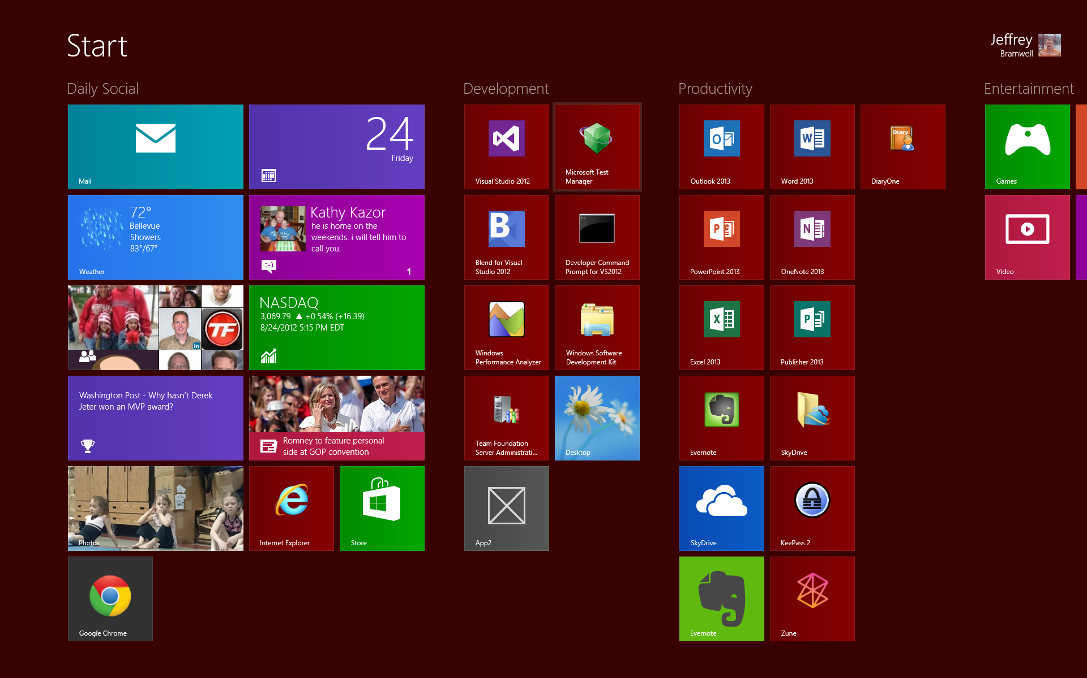



Introduction to Windows 8 Development
Let’s Go Metrow
Jeff Bramwell
Director - Enterprise Architecture
Farm Credit Services of America
jbramwell@gmail.com|@jbramwell devmatter.blogspot.com
Heartland Developers Conference
Thursday, September 6th, 2012
10:15 AM Room 200
Notes:
Who am I and why do you care? ☺

Slide 2
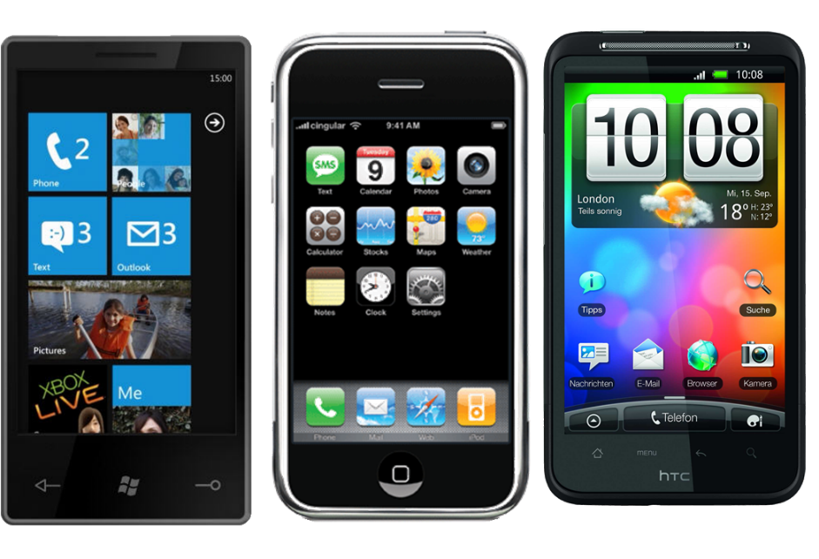

Please Be Courteous!
Please be courteous to your fellow attendees
and
Set your phones to vibrate or silent mode!

Slide 3

Notes:
Explain the twitter-based game.

Slide 4
Agenda
Tools
Runtime / Architecture
Development Features
Windows Store
Resources & Links
Questions

Slide 5

Tools

Slide 6
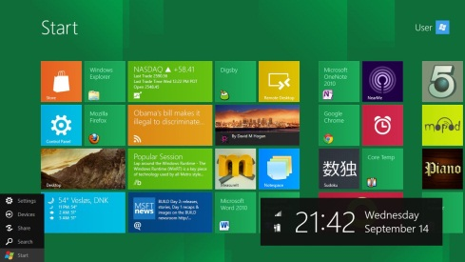
Windows 8 SKUs
X86/64
Windows 8
Targeted toward home users
Matches closest to Windows 7 “Home” editions
Windows 8 Pro
Targeted toward business and enthusiast users
Matches closest to Windows 7 Professional and Ultimate editions
Windows 8 Enterprise
Targeted toward businesses
Available only through Software Assurance
Windows RT
Pre-installed on ARM-based devices
ARM
← Don’t confuse this with WinRT or Windows Runtime ☺
Notes:
Windows RT will not be available for general purchase. It will be available, pre-installed, on ARM devices only.
Don’t confuse “Windows RT” with “WinRT”; They’re not the same thing. ☺
More information regarding SKUs at: http://en.Wikipedia.org/wiki/Windows_8_editions

Slide 7
Get the Tools
Visual Studio 2012
Visual Studio Express 2012 for Windows 8
Visual Studio Professional 2012
Visual Studio Premium 2012
Visual Studio Ultimate 2012
Blend for Visual Studio 2012
UI Design and Development
Optional
.NET Framework 4.5
Included with Windows 8
Installed with Visual Studio 2012 on non-Windows 8 devices
(FREE)
Notes:
In most cases you don’t need to worry about the .NET Framework 4.5 since it is included with both Windows 8 and Visual Studio 2012. However, you may need to install it on application servers or other machines depending upon the target application type and dependencies.
There is currently no Express SKU for building .NET/Desktop apps. A “Desktop” Express SKU has been announced for the Fall but no official release date has been announced → http://blogs.msdn.com/b/visualstudio/archive/2012/06/08/visual-studio-express-2012-for-windows-desktop.aspx

Slide 8
UX / Runtime / Architecture

Slide 9
What is “Metrow”
A “code” name ☺
Windows Store application
Content over chrome
Fast and fluid
Touch first
Snap and scale beautifully
Use of contracts
Application tile
Connected; Roam to the cloud
Authentically digital
Notes:
Take a look at some of the out-of-the-box RT apps that ship with Windows 8… they all focus on content rather than chrome.
They provide a “fully immersive” (full screen) experience.
When designing “Metro” apps, design the user interface to allow for a great “touch first” experience. This includes gestures as well as just “touch”. Use the VS 2012 simulator to simulate touch experiences on a non-touch enabled screen.
Use of contracts allow for a consistent usage pattern across applications on Windows 8.
Utilizing the cloud allows your settings to follow you from device to device.
Create your applications to utilize the features of the device; do not simulate “real world” interfaces (e.g. spiral bound notebooks). In other words, be authentically digital.

Slide 10
Windows Runtime (WinRT)
New programming model for Windows 8
Supports C#, VB.NET, C++, and JavaScript
Supported on x86 and ARM architectures
Windows metadata provides cross-language support
Complete description of Windows Runtime
Allows for multi-language projection
Full IntelliSense
Asynchronous APIs
Windows.* namespaces include Windows Runtime types
Notes:
Standard .NET applications are supported in Windows 8 in “desktop” mode only – not using the new “Metro” style.
All WinRT assemblies are referenced automatically when you create a new Windows Store Application.
Don’t confuse “Windows RT” with “WinRT”; They’re not the same thing. ☺

Slide 11
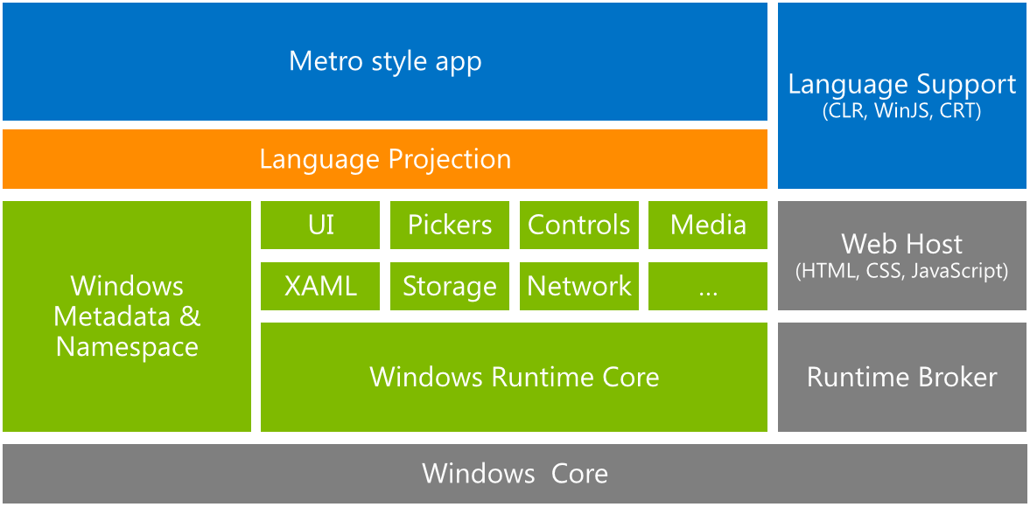
Windows Runtime Architecture

Slide 12

Development Features

Slide 13
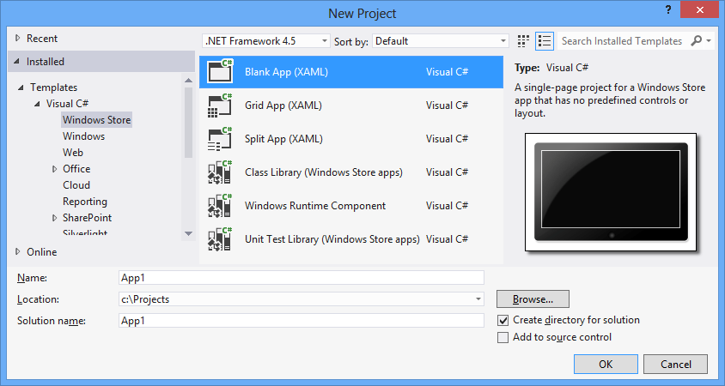

Creating a Windows 8 App
Visual Studio 2012
Windows Store Templates
Several Project Types

Slide 14
Roaming Data
Built-in data roaming capabilities
Uses Microsoft Account
Simple to use:
Windows.Storage.ApplicationData.Current.RoamingSettings.Values["StoredValue"] = StoredValue.Text;
Use RoamingFolder for file-based data
Roaming storage quota = 100KB
If you exceed quota, nothing syncs (though it still persists)
Use HighPriority for preserving application context
Use a CompositeSettingValue to roam related items
Notes:
If you exceed quota, the settings will be saved locally but will not sync to the cloud.
High priority items must be under 8KB to roam as “high priority”. If the High priority item exceeds 8KB, it will be roamed as a “normal” setting (i.e. it could take a few minutes before it syncs).
Applications can be ran/debugged:
Locally (against development hardware)
Locally in Simulator (Great for testing data roaming)
Remotely (e.g. on a Windows 8 tablet)

Slide 15
Contracts & Extensions
Contracts
App to App Picking
Play To
Print
Search
Settings
Share
Extensions
Account picture provider
AutoPlay
Background tasks
Camera settings
Contact picker
File activation
Game Explorer
Print task settings
Protocol activation
SSL/certificates
Notes:
Main difference between Contracts & Extensions is that contracts are between two apps whereas extensions allow you to extend Windows capabilities.

Slide 16
File Picker
FileOpenPicker
Presents a list of files (as a list or thumbnails) for selection
SkyDrive support built in
Returns a Windows.Storage.StorageFile
FileSavePicker
Allows you to save a file to a selected location
SkyDrive support built in
Returns a Windows.Storage.StorageFile
Notes:
StorageFile has various (asynchronous) read/write methods for reading/writing files.

Slide 17
Settings Contract
Implemented via SettingsCommand
Displayed via User Control hosted in Popup
Various ways to implement
Widths of 346px or 646px supported
Notes:
Settings Panel guidance: http://msdn.microsoft.com/en-us/library/windows/apps/hh770544.aspx

Slide 18
App Bars
Similar in concept to menu bar in Windows Phone
Use top App Bar for Navigation
Use bottom App Bar for Commands
Use <AppBar /> XAML control to add an app bar to your app
Can create your own icons – or – utilize Segoe UI Symbol
Notes:
Can use a tool like Syncfusion’s Metro Studio to build custom icons
Need to add reference to App Bar guidelines

Slide 19
Application lifecycle
Running
NotRunning
Suspended

Slide 20
Application lifecycle
Use PreviousExecutionState when Launching
NotRunning
Running
Suspended
Terminated
ClosedByUser
Use SuspendingOperation.GetDeferral() when Suspending
No special check required when Resuming

Slide 21
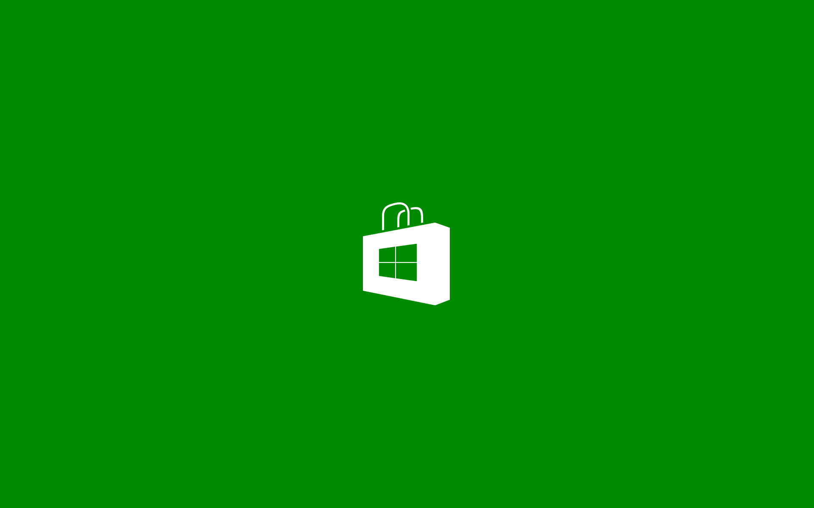
Windows Store

Slide 22
Windows Store
Integrated into Visual Studio 2012
Open Developer Account
Reserve App Name
Good for 1 year
Acquire Developer License
Tied to Microsoft Account
License per machine
Free

Slide 23
Windows Store (cont’d)
Edit App Manifest
Associate App with Windows Store
Based on reserved apps
Capture Screenshots
Create/Upload App Packages

Slide 24
Summary
Tools
Windows 8
Visual Studio 2012
.NET Framework 4.5
Runtime / Architecture
Windows Runtime
Development Features
Roaming Data
Contracts & Extensions
File Picker
Settings
App bars
Application Lifecycle
Windows Store
Registration
Packaging
Publishing

Slide 25

Resources & Links

Slide 26
Download Links
Windows 8 RTM
MSDN and Evaluation versions
Visual Studio Express 2012 for Windows 8
The FREE version
Templarian Icons
Great, free Windows 8/Phone Icons
Syncfusion Metro Studio
Easily create great Windows 8/Phone Icons
Windows 8 Dev Camp in a Box
A wealth of resources and information

Slide 27
Resources
How to Develop a Windows 8 App in 30 Days
Windows Metro Style Apps Forums
Windows 8 Code Samples
Windows 8 on Stack Overflow

Slide 28
Related Sessions
Thursday
09:00 – K1 – Keynote Session – Windows 8 and the Future of Client Development w/Pete Brown
Already over ☺
10:15 – Session 201 – Getting Started with Windows 8 Development – Go Metro!
This session ☺
10:15 – Session 401 – C++/CX and WinRT: Just Enough C++ To Get By On w/Michael Price
Same time as this session ☺
Friday
13:15 – Session 208 – Understanding the Metro UX – A Developer Perspective w/Jeff Brand
You don’t want to miss this one!
14:15 – Session 309 – Cross-Platform, Cross-Device, Connected-Apps Oh My! w/Mike Benkovich
Building Connected Windows 8 Applications with Windows Azure

Slide 29
Questions
?

